Slide 1
Qa fundamental project
Oliver Stockman

Slide 2
JIRA
First listed all of the user stories that would be required to fulfil the domain and the project extension
thought about the most important ‘should-haves’ for the application
Broke the user stories down into sub-tasks so that I could estimate the story points each story would take up
Created a first sprint that encompassed the stories and tasks required in order to fulfil the projects mvp
Prioritised the remaining stories into should-haves and could haves and grouped them into logical sub-projects:
Extension to crud functions
Implement a user system
Create a gui-based front end for the system

Slide 3
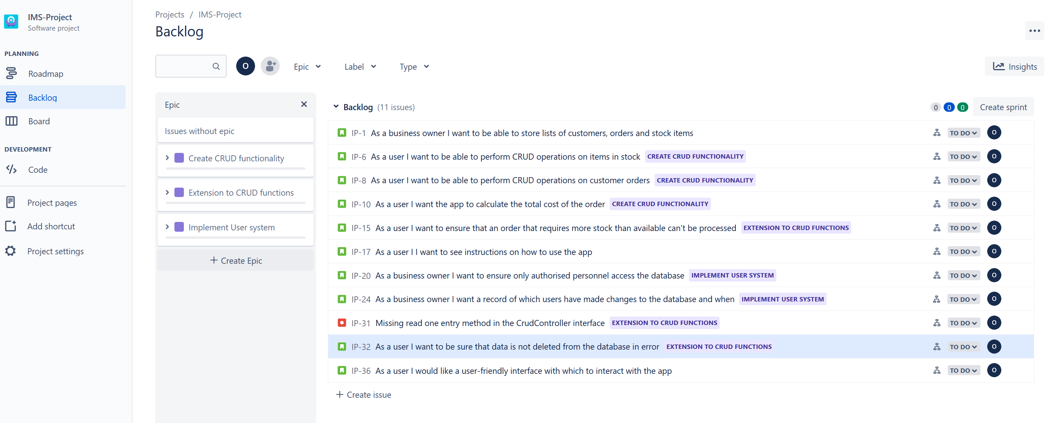
Backlog at start of project

Slide 4
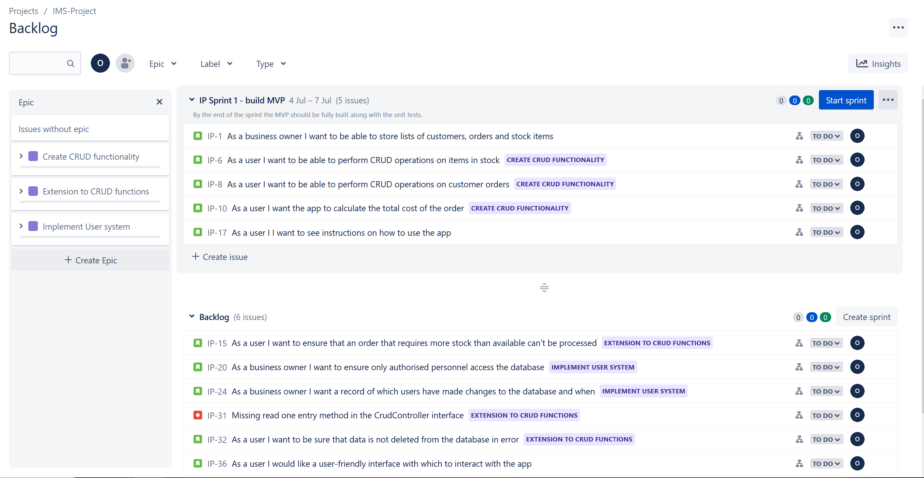
Backlog with sprint#1 assigned

Slide 5
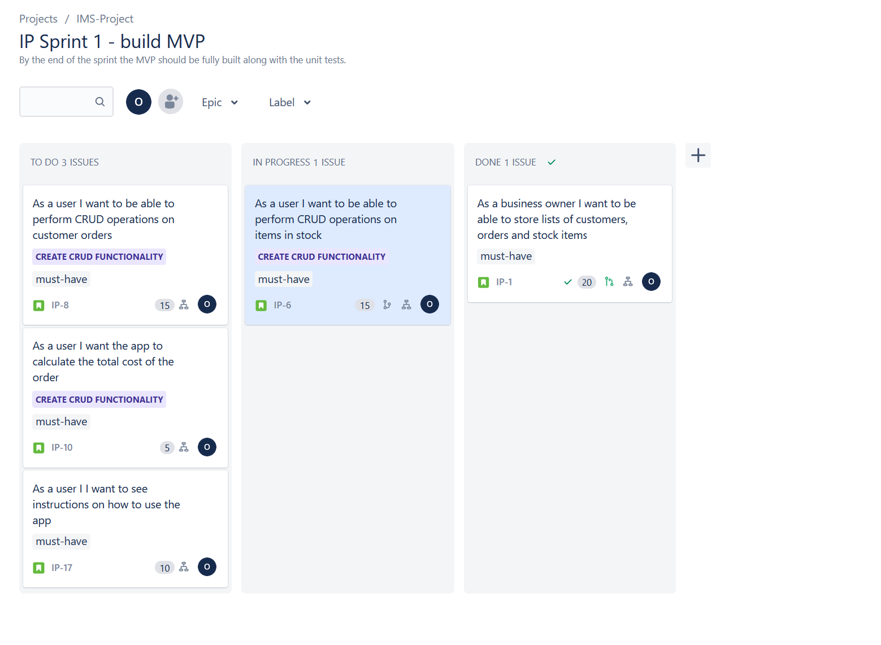
Kanban board early in sprint #1

Slide 6
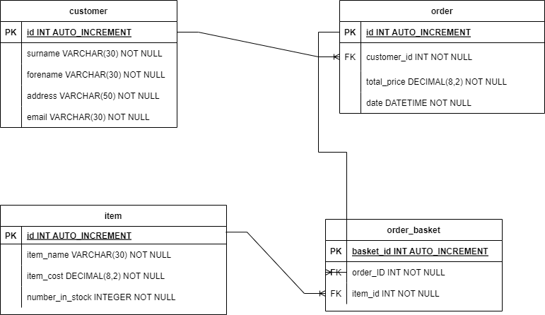
Erd at start of project including extended crud functions

Slide 7
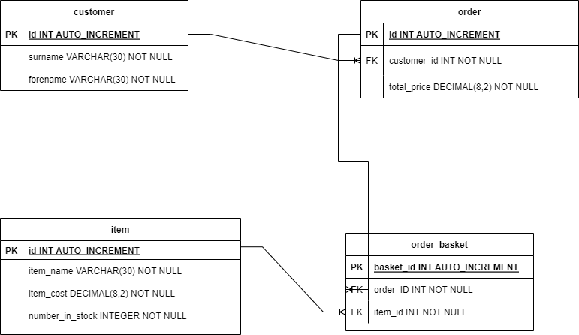
V2 erd showing mvp functionality

Slide 8
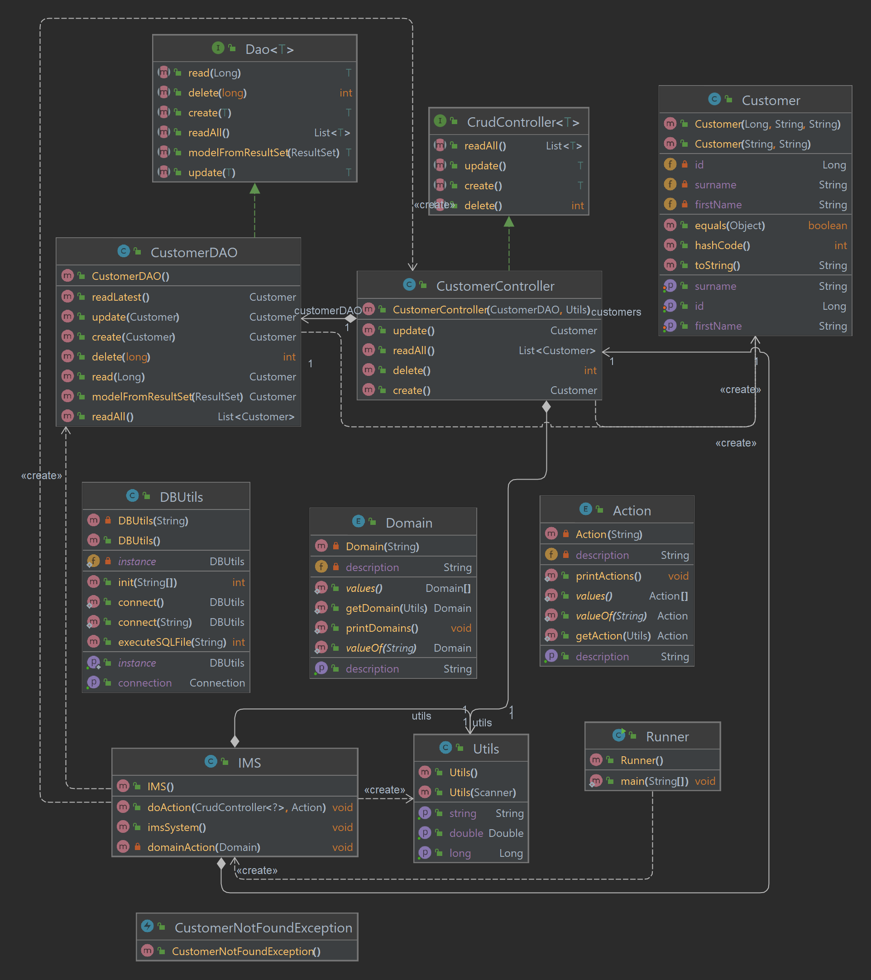
Uml at start of project – skeleton stage

Slide 9
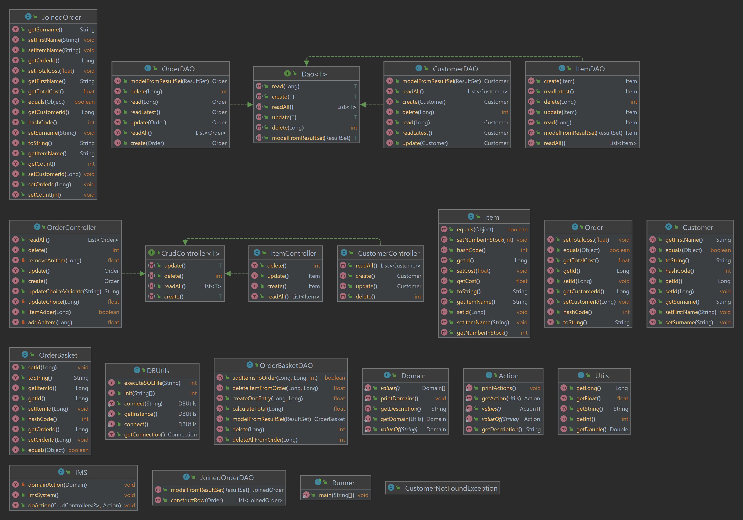
Uml at current mvp stage

Slide 10
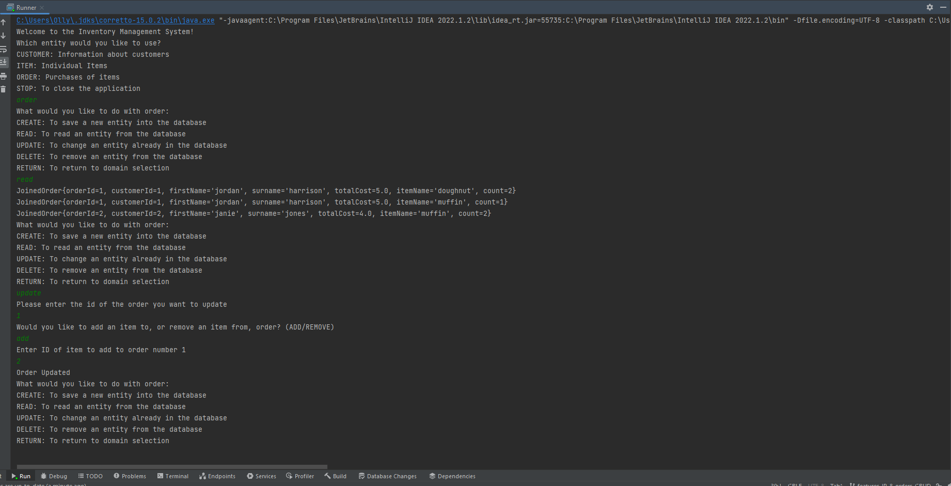
Code demo

Slide 11
Testing strategy
Plan was to have entities and DAOs unit tested using junit, in order to ensure their functionality
Integration testing, using Mockito, to be carried out on the controller and utils classes
Overall target for test coverage was 80%, as this mirrors industry standards

Slide 12
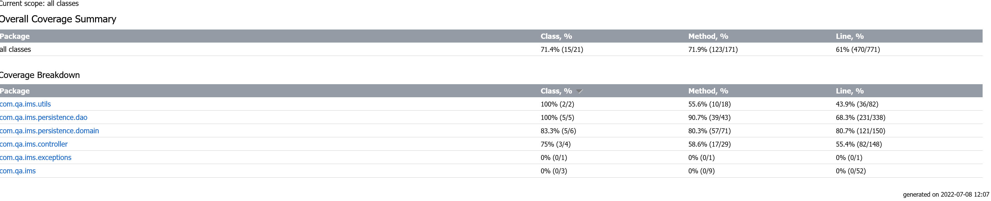
Testing outcomes
Coverage fell short of plan due to:
time constraints
need for refactoring of some methods to make testing more practical
Further experience needed with mockito

Slide 13
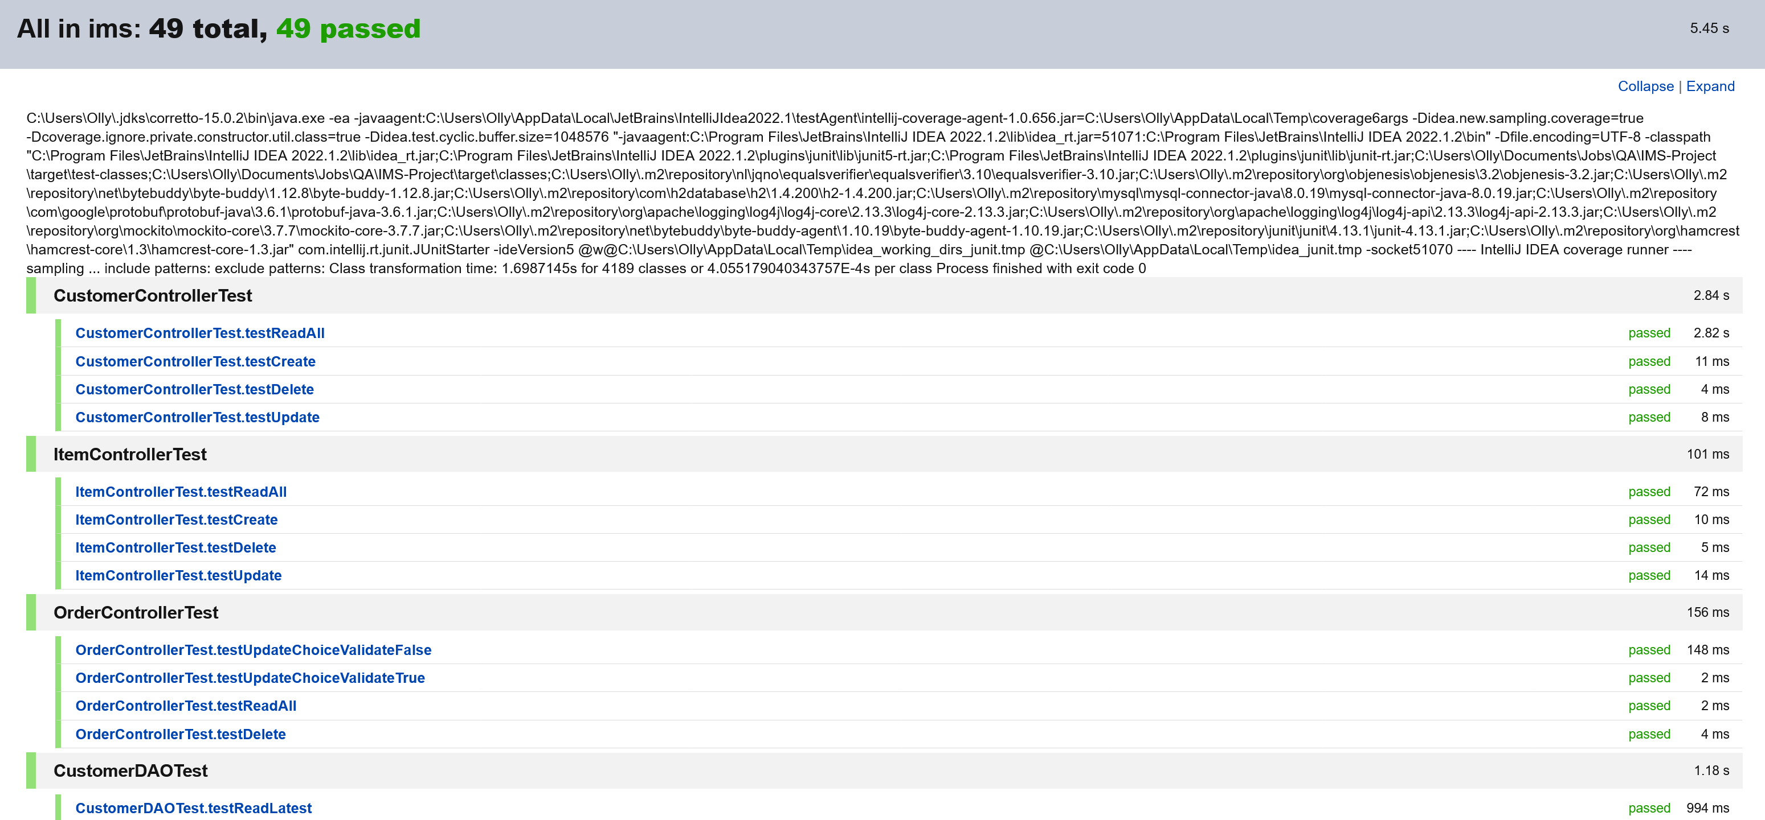
Testing positives
WHILE FULL COVERAGE NOT ACHIEVED, ALL TESTS THAT WERE CREATED WERE SUCCESSFUL
REFACTORING, IN PARTICULAR OF THE ORDER CONTROLLER AND DAO, WOULD ALLOW COVERAGE TO BE IMPROVED IF MORE TIME WERE AVAILABLE

Slide 14
conclusion
positives
Mvp is functional
Reasonable test coverage achieved
Jira and erd plans were largely kept to, with adaptations occurring as the project went on
Negatives
Time constraints meant that the level of refactoring that was possible was limited
Disappointed not to get the extended crud functionality completed
Progress somewhat hindered by lack of experience in using some tools such as Mockito and maven
Software version issues were frustrating at times
Lessons for future projects
Ensure comfort with whole toolchain being used before starting a project
Take a greater consideration of testing practicalities when designing methods – try to maintain a greater modularity between them
split tasks into smaller sections to avoid getting bogged down when dealing with classes that are heavily interdependent for the achievement of functions

Slide 15


